Slide 1
What is Electrical Grid?
Interconnected network for delivering electricity.
Complicated Network.
Requires a great deal of real time monitoring.
Purpose Of Synchronization
To prevent abnormalities due to difference in two signals.
Conditions to meet before synchronizing:
Equal Line Voltage
Same Frequency
Same Phase Sequence
Equal phase angles
And; similar waveform
Why to study Synchronization?
Main Reason is due to Dynamic Loading. It can cause supply current out of phase with supply current.

Slide 2
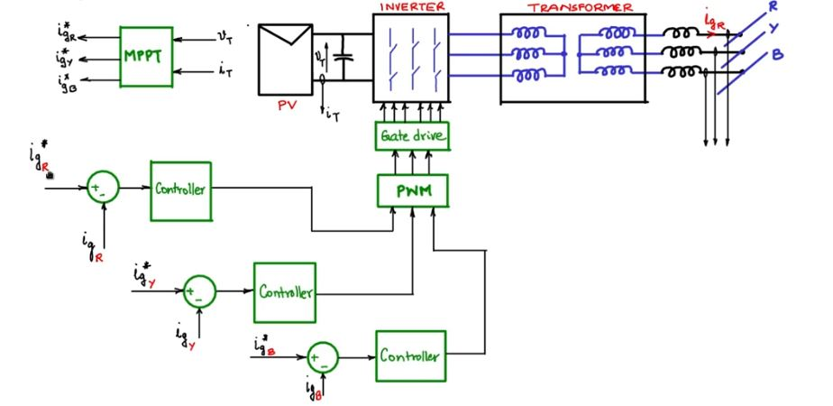
Case Study: A grid Connected PV Module
Fig. Block diagram of 3-ф Grid Connection of a PV module

Slide 3
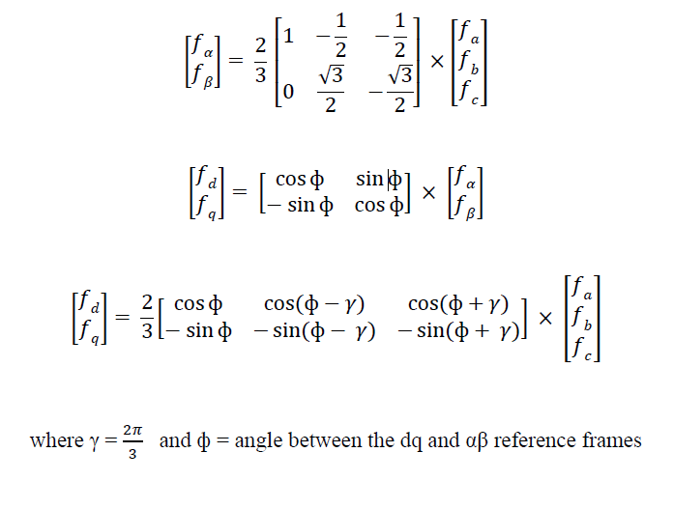
DQ Axis Theory
The DQ transformations can be used to rotate the reference frames of AC waveforms such that they become DC signals
Conversion from abc to alpha-beta domain

Slide 4
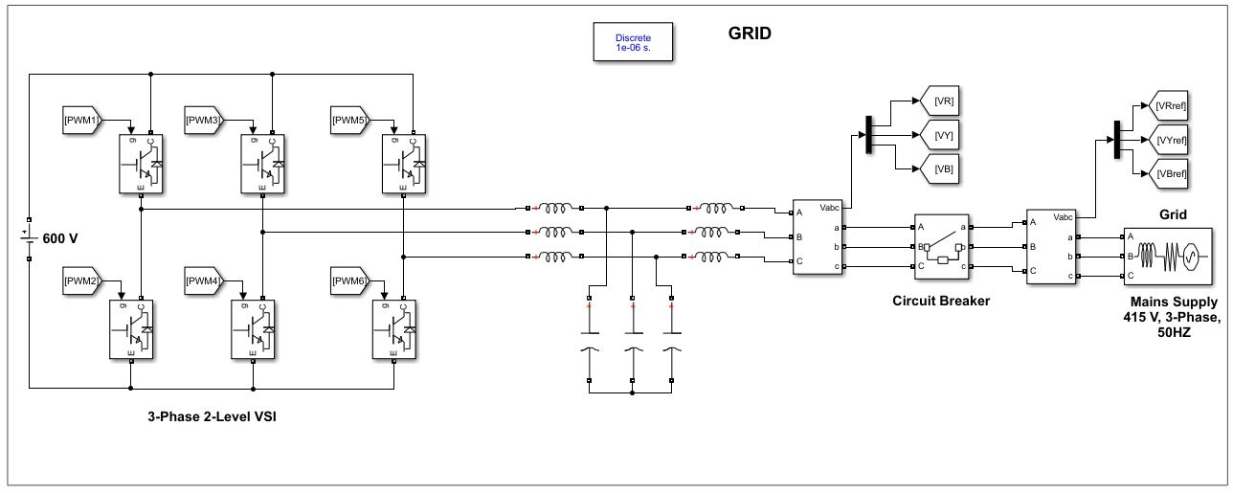
Connection of Inverter to Grid

Slide 5
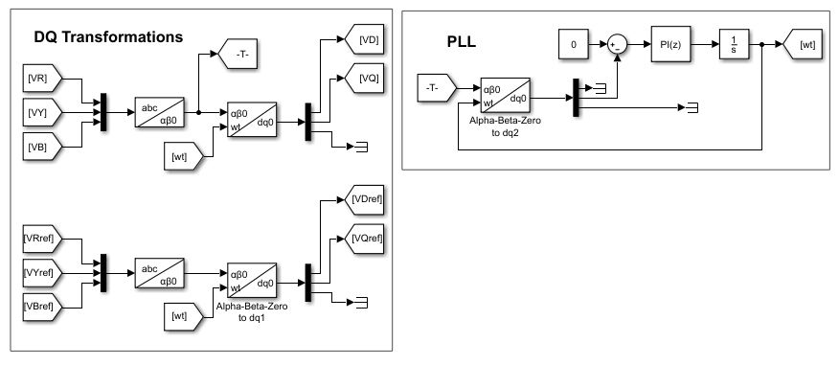
Phase Locked Loop Block and DQ Transformation

Slide 6
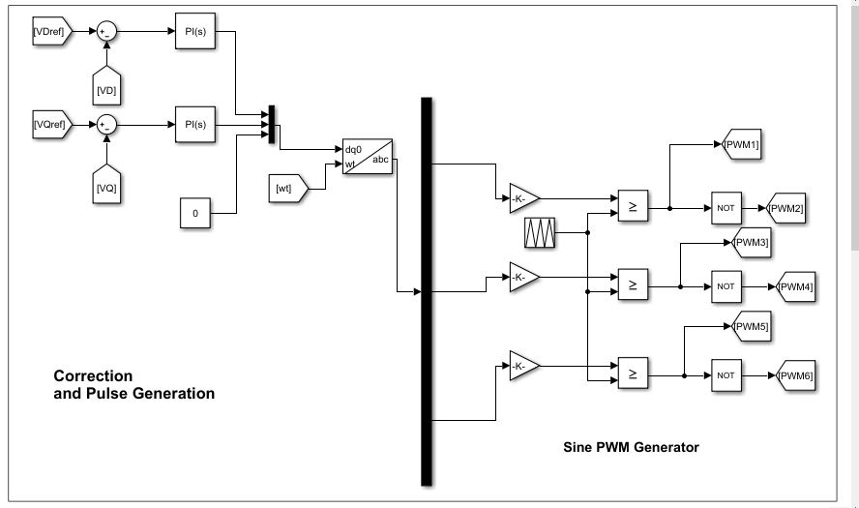
Correction and Generation of Gate Pulses

Slide 7
Simulation Results:
Inverter Output Voltage

Slide 8
Frequency and Phase Angle Variation

Slide 9
Synchronisation Time

Slide 10
Gate Pulses Supplied to Inverter

